Slide 1
Classifying Evoked Potentials from Spinal Cord Microelectrode Array Data
Jeremy Ford, Samantha Russman, Margot Wagner
COGS 260
Spring 2020

Slide 2
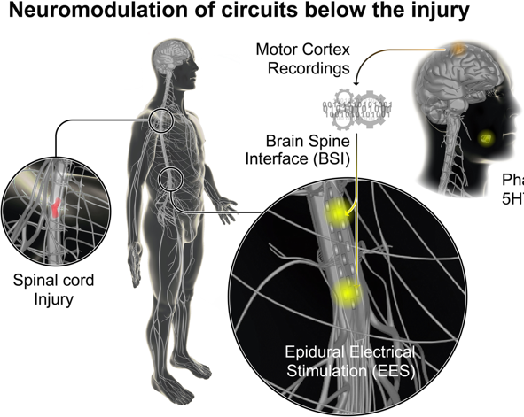
Brain-spine interfaces for treatment of spinal cord injury
A wireless brain-spine interface (BSI) could restore movement and sensation in patients with spinal cord injury.
Spinal cord electrical stimulation and recording via microelectrode arrays can relay information between the brain and the body.
Two pathways must be restored:
Sensory information
Motor information
SENSORY NEURONS (LIMBS) → SPINAL CORD SENSORY EVOKED POTENTIALS→ SOMATOSENSORY CORTEX
Cho et al. 2019
MOTOR CORTEX → SPINAL CORD MOTOR EVOKED POTENTIALS → MOTOR NEURONS (LIMBS)
Transmitting sensory information to/from the spinal cord requires classification of sensory evoked potentials.
Notes:
Spinal cord injury: debilitating, life-long condition
Currently limited treatment strategies exist
Recently, brain-spine interfaces have gained a lot of interest

Slide 3
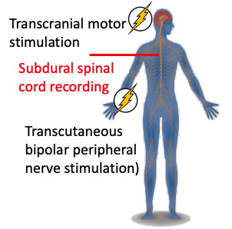
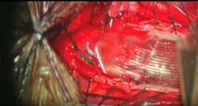
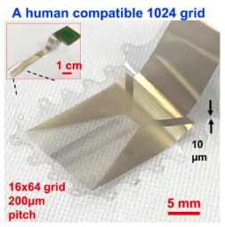

Experimental setup & collected data
We performed peripheral sensory nerve stimulation in a patient undergoing a spinal cord tumor resection and recorded from the spinal cord with a microelectrode array with 100s of contacts.
Stimulation varied based on side of the body and stimulus level and was administered with neurophysiology monitoring equipment.
Can a supervised learning model classify different types of sensory evoked potentials from recordings of electrical activity in the spinal cord?
Peripheral nerve stimulation
Left side 60mA, 30mA
Peripheral nerve stimulation
Right side 60mA, 30mA
Electrode placement on spinal cord
Electrode layout
32x16 contacts
Notes:
We used experimental data from the Dayeh Lab.

Slide 4
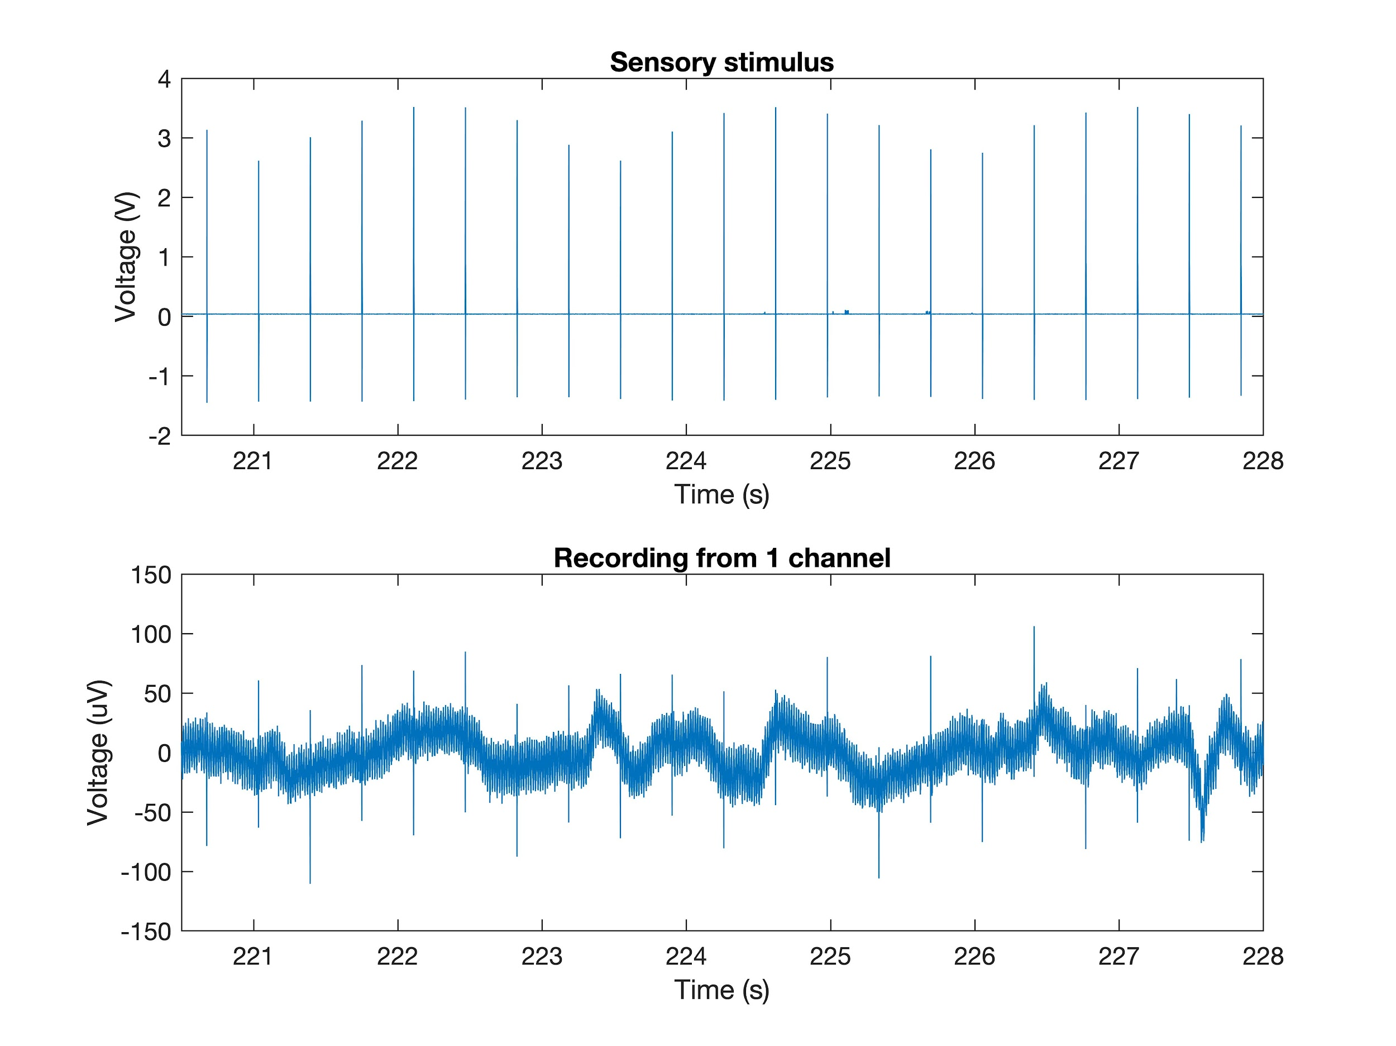
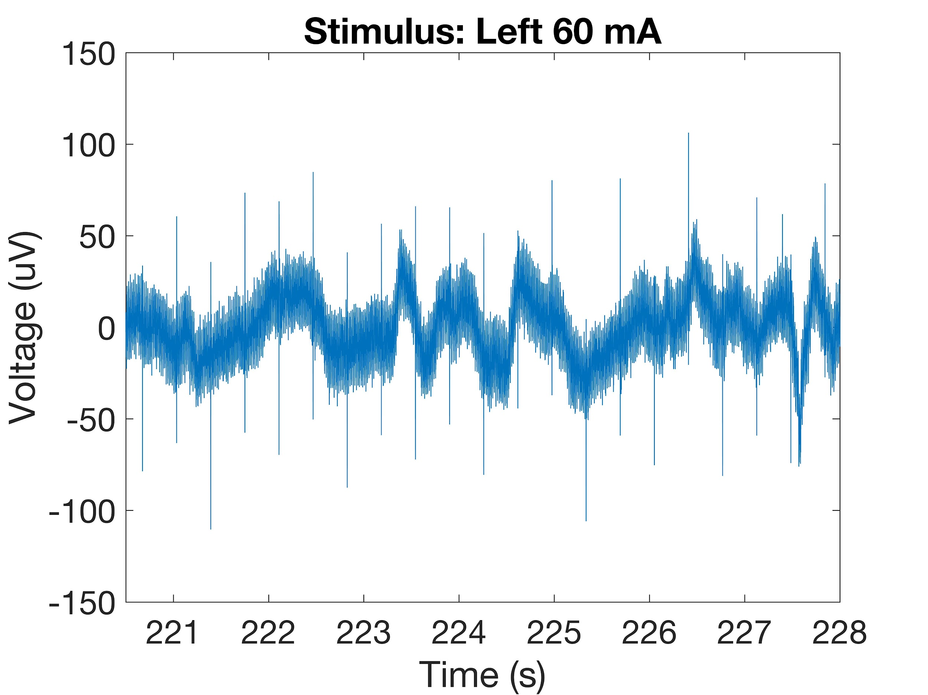
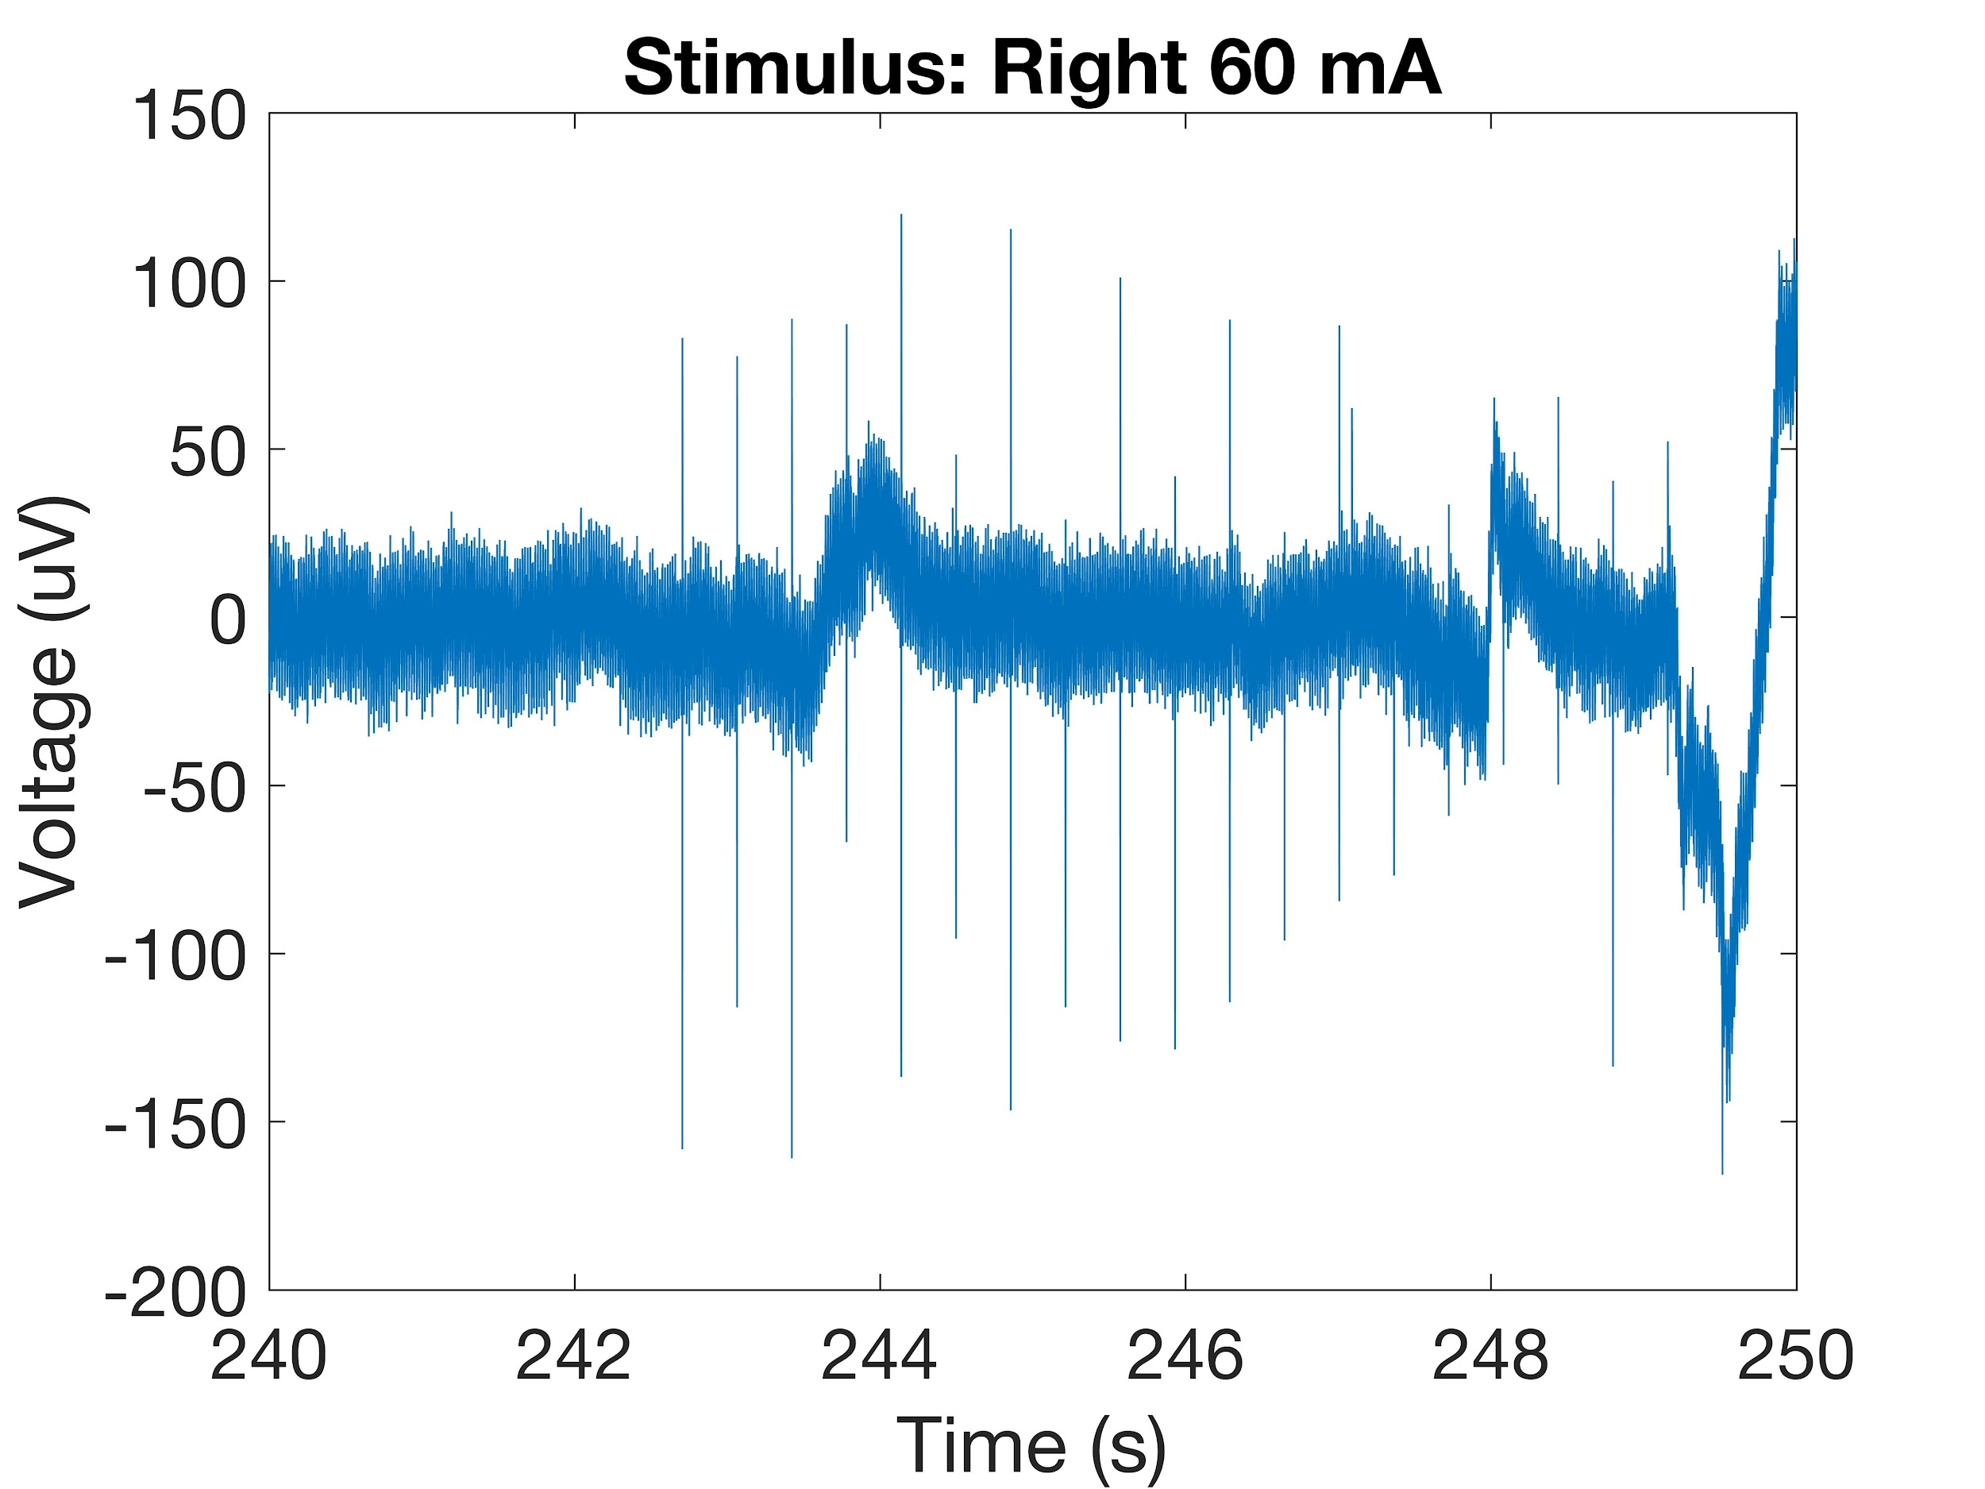
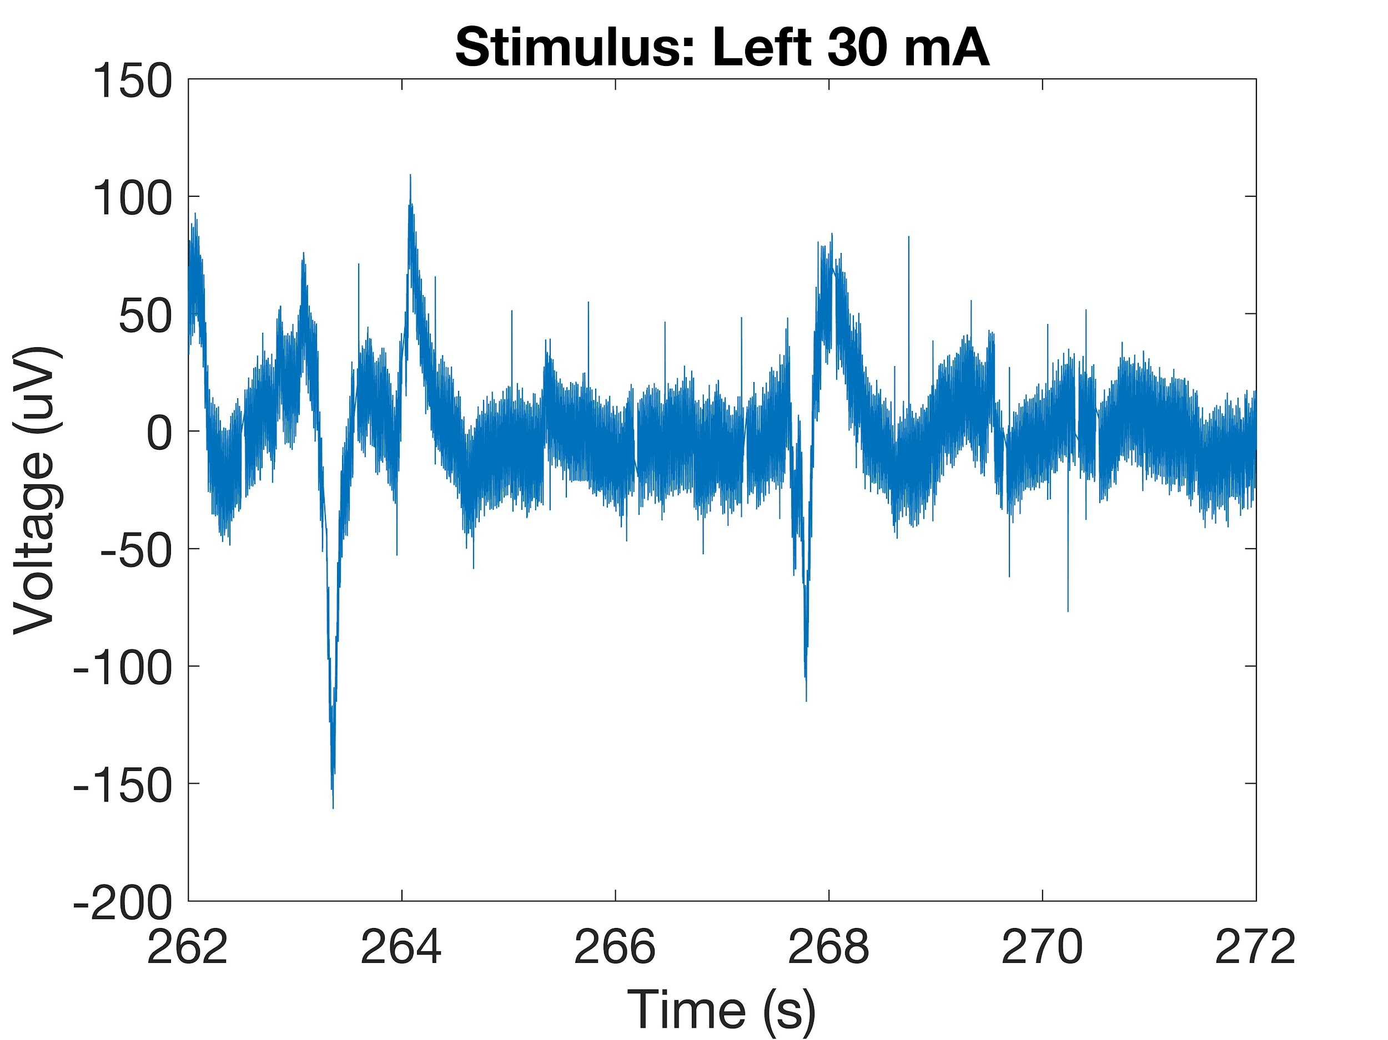
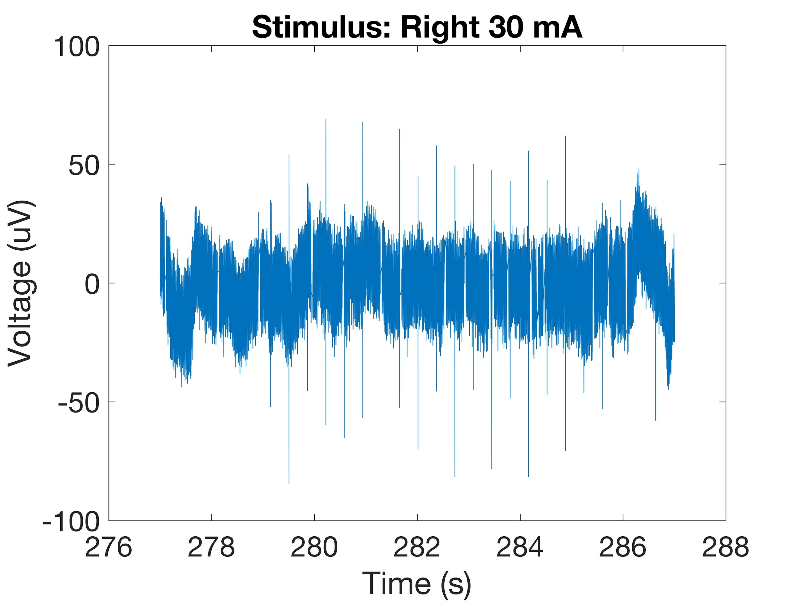
Data preprocessing
1. Alignment
2. Windowing

Slide 5
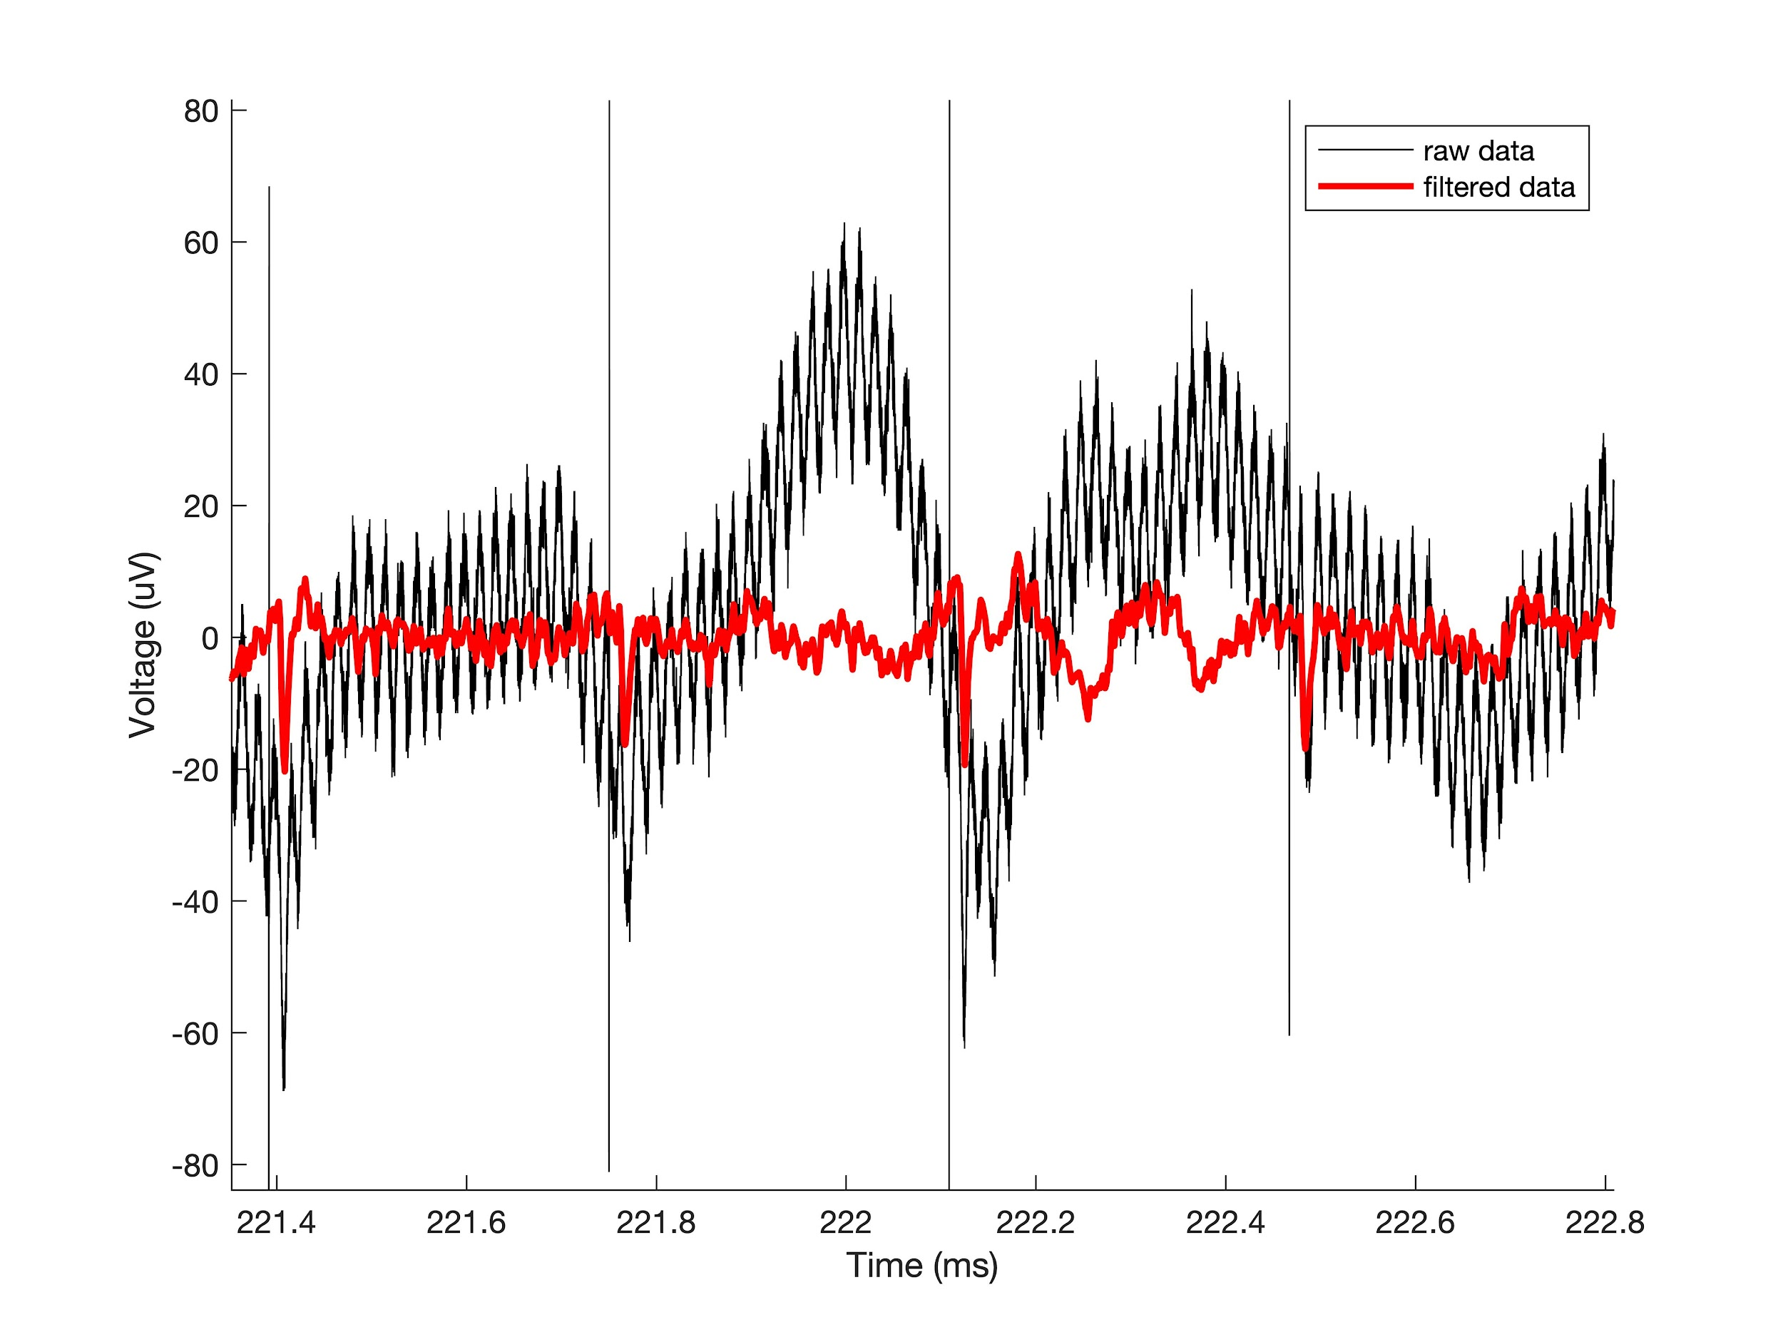
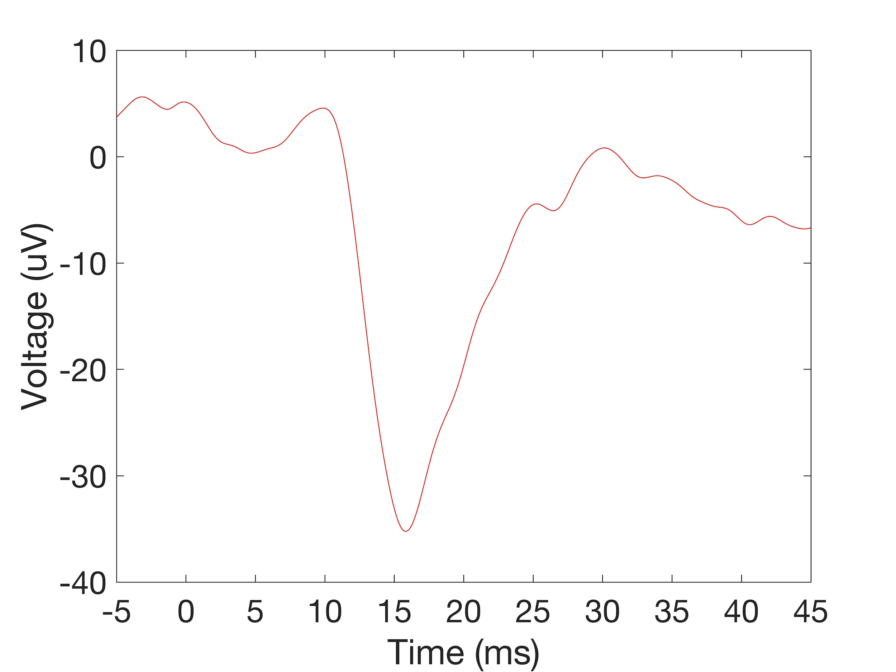
Data preprocessing
3. Filtering
4. Initial bad channel selection
Notch filters for 60 Hz noise and harmonics
Bandpass filter [3 300 Hz] → captures LFP behavior
Based on impedance measurements for all channels.
Impedances below 150 kOhms
Resulted in 353 “good channels”
5. Segmentation into individual trials
Notes:
LFP frequency range likely to be the frequency range of interest.

Slide 6
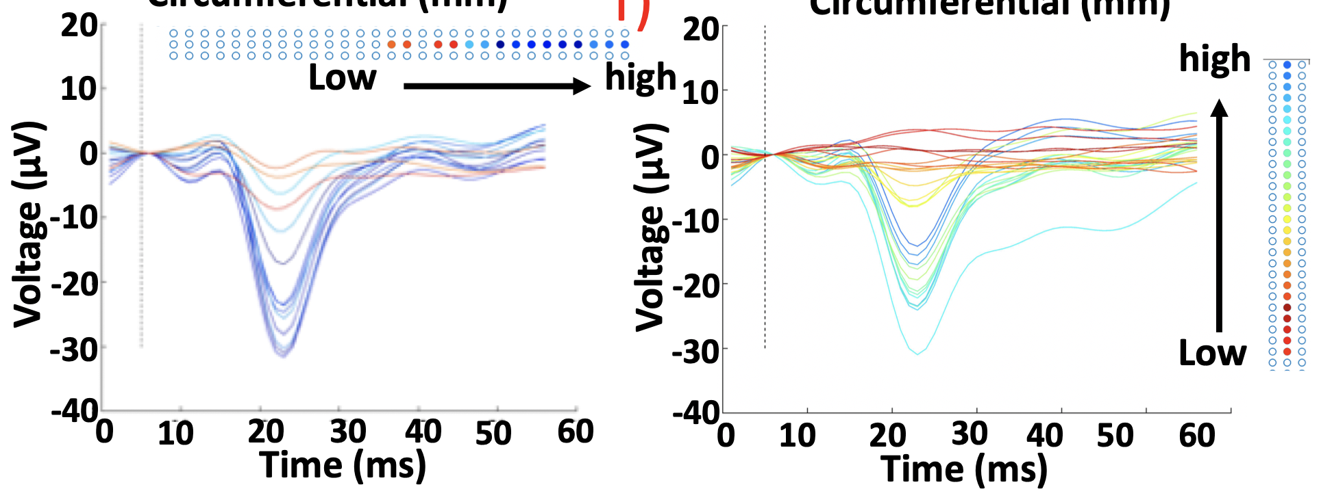
Assessing recordings before classification
Notes:
Averaged responses across trials for 60 mA left stimulation.

Slide 7
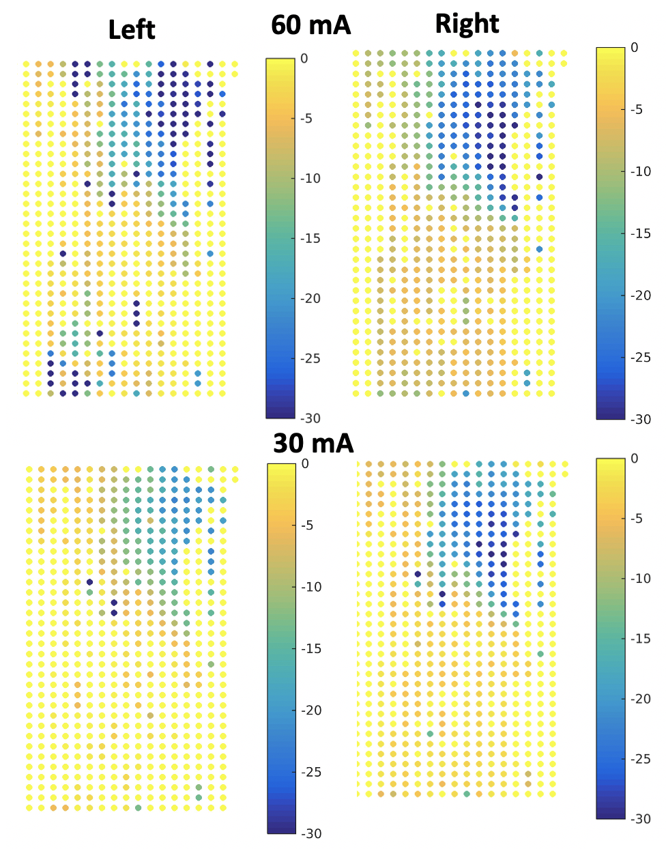
Assessing recordings before classification

Slide 8
Hypothesis & project goal
Goal: Detect and classify single evoked potentials in a short time-window of data recorded from a 300+ channel microelectrode array placed subdurally on the spinal cord surface.
The five classes of interest are:
sensory evoked potentials at 60 mA stimulation (left and right)
sensory evoked potentials at 30 mA stimulation (left and right)
no evoked potentials (baseline)
Input dataset is 50 ms long and sampled at 20 kHz
Initial hypothesis: extracting the top principal component (PC) from the input data will be sufficient to achieve a 50% classification accuracy rate via a multiclass linear discriminant analysis.

Slide 9
Analysis - Outline
Preprocessing
Dimensionality Reduction and Feature Extraction
Classification

Slide 10
Analysis - Outline
Preprocessing
Dimensionality Reduction and Feature Extraction
Classification

Slide 11
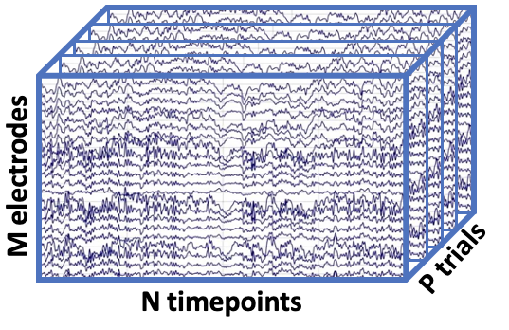
Analysis - Data Matrix
1 Condition

Slide 12
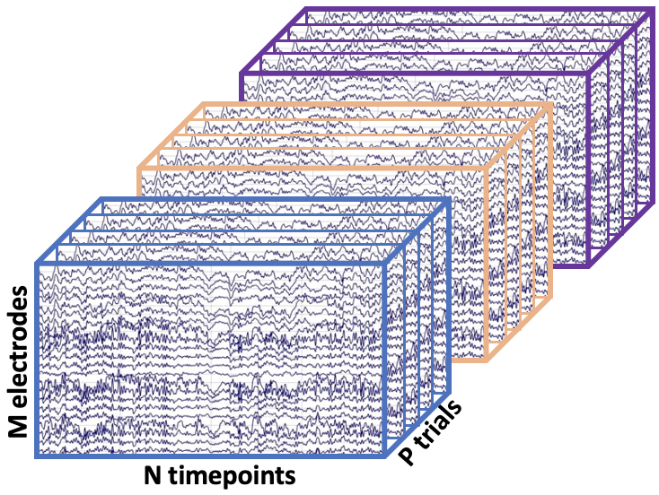
Analysis - Data Matrix
D Different Conditions

Slide 13
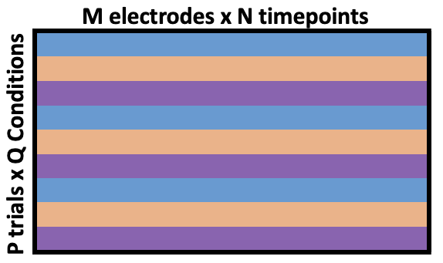
Analysis - Data Matrix Reshaping
Dimensionality reduction requires a 2D matrix

Slide 14
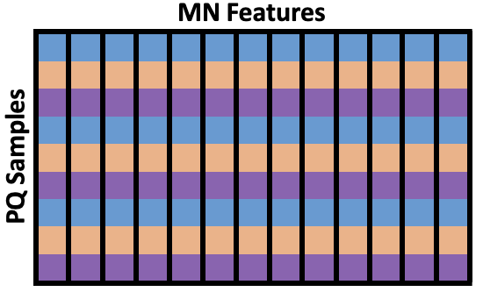
Analysis - Data Matrix Reshaping
Samples x Features
Mean centered data: zero mean across features

Slide 15
Analysis - Outline
Preprocessing
Dimensionality Reduction and Feature Extraction
Classification

Slide 16
Analysis - Principal Component Analysis (PCA)
PCA: Dimensionality reduction technique decomposing the data into variance directions and magnitudes and keeping the directions of highest variance.
Keeps the most “informative” dimensions
Unsupervised - no labels
Notes:
https://royalsocietypublishing.org/doi/10.1098/rsta.2015.0202

Slide 17
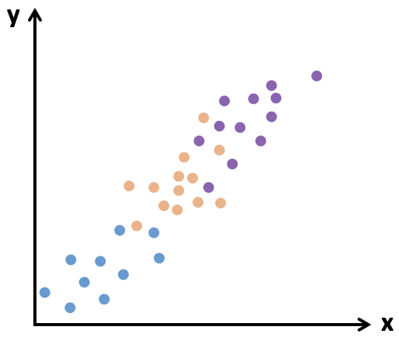
Analysis - Principal Component Analysis (PCA)
Dimensionality reduction
Create new uncorrelated variables (principal components) that maximize variance
These variables are linear functions of the original variables

Slide 18
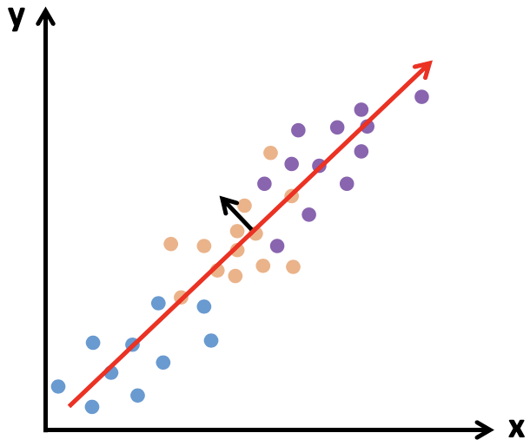
Analysis - Principal Component Analysis (PCA)
Dimensionality reduction
Create new uncorrelated variables (principal components) that maximize variance
These variables are linear functions of the original variables

Slide 19
Analysis - Principal Component Analysis (PCA)
2. Reduce the dimensionality of the dataset by keeping the components with the most variance, or spread.

Slide 20

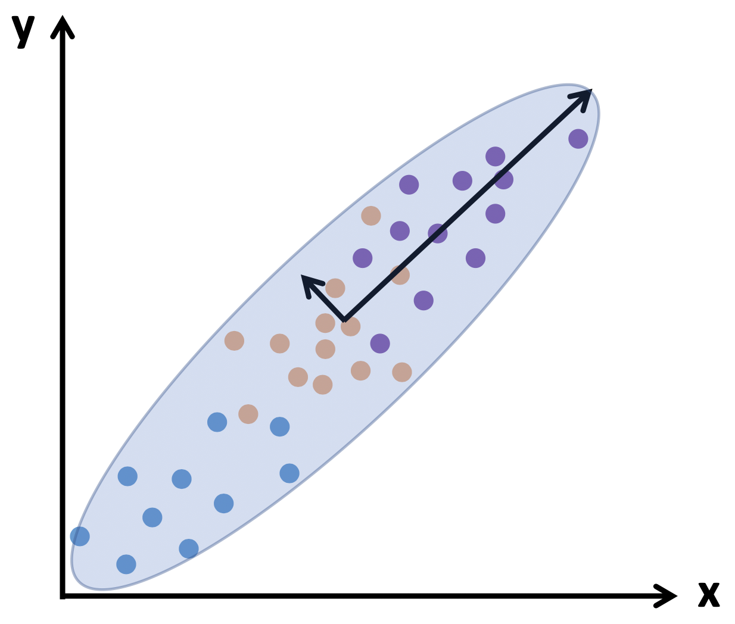
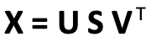
Analysis - Singular Value Decomposition (SVD)
https://en.wikipedia.org/wiki/Singular_value_decomposition
Notes:
A 2D matrix X represents some scaling and vector direction (ie applied to a unit disc)
SVD decomposes this into a rotation of the vectors, a scaling/shearing, and a rotation of the entire ellipse

Slide 21
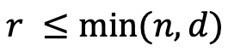

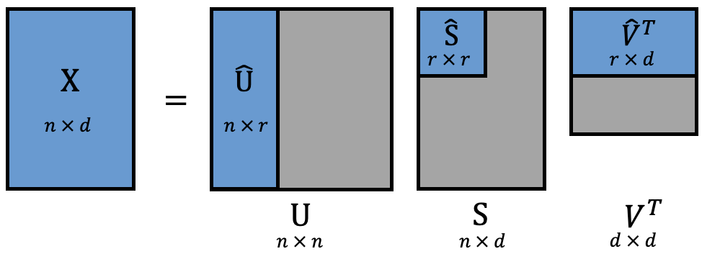
Analysis - Singular Value Decomposition (SVD)
For an n x d data matrix X:
U: Eigenvectors of XX
V: Eigenvectors of X X - Principal directions or axes
S: Singular values - Eigenvalues of XX - diagonal matrix
Can limit the resulting size of the matrix -
Transformed data (principal components): XV = US
T
T
T

Slide 22
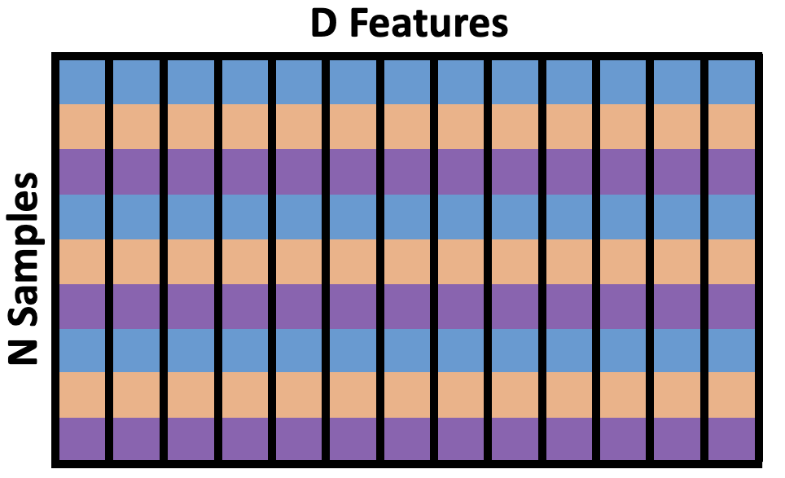
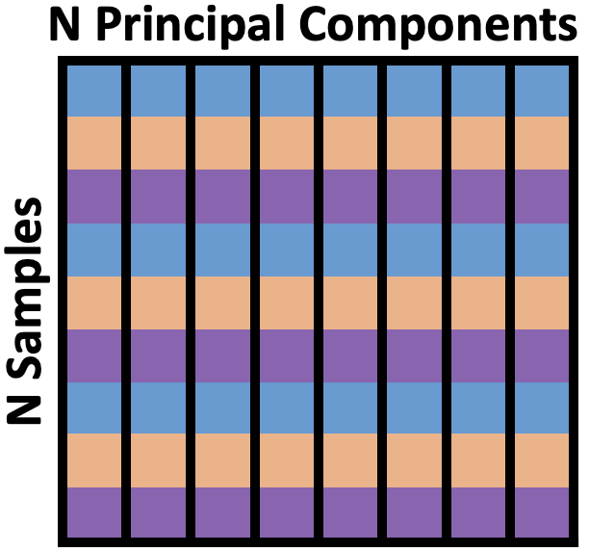
Analysis - Principal Component Analysis (PCA)
Transform data onto principal axes
Select a subset of principal components to reduce dimensionality while being able to explain data

Slide 23
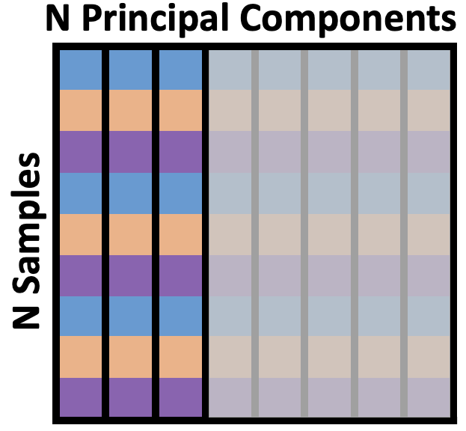
Analysis - Principal Component Analysis (PCA)
Transform data onto principal axes
Select a subset of principal components to reduce dimensionality while being able to explain data

Slide 24
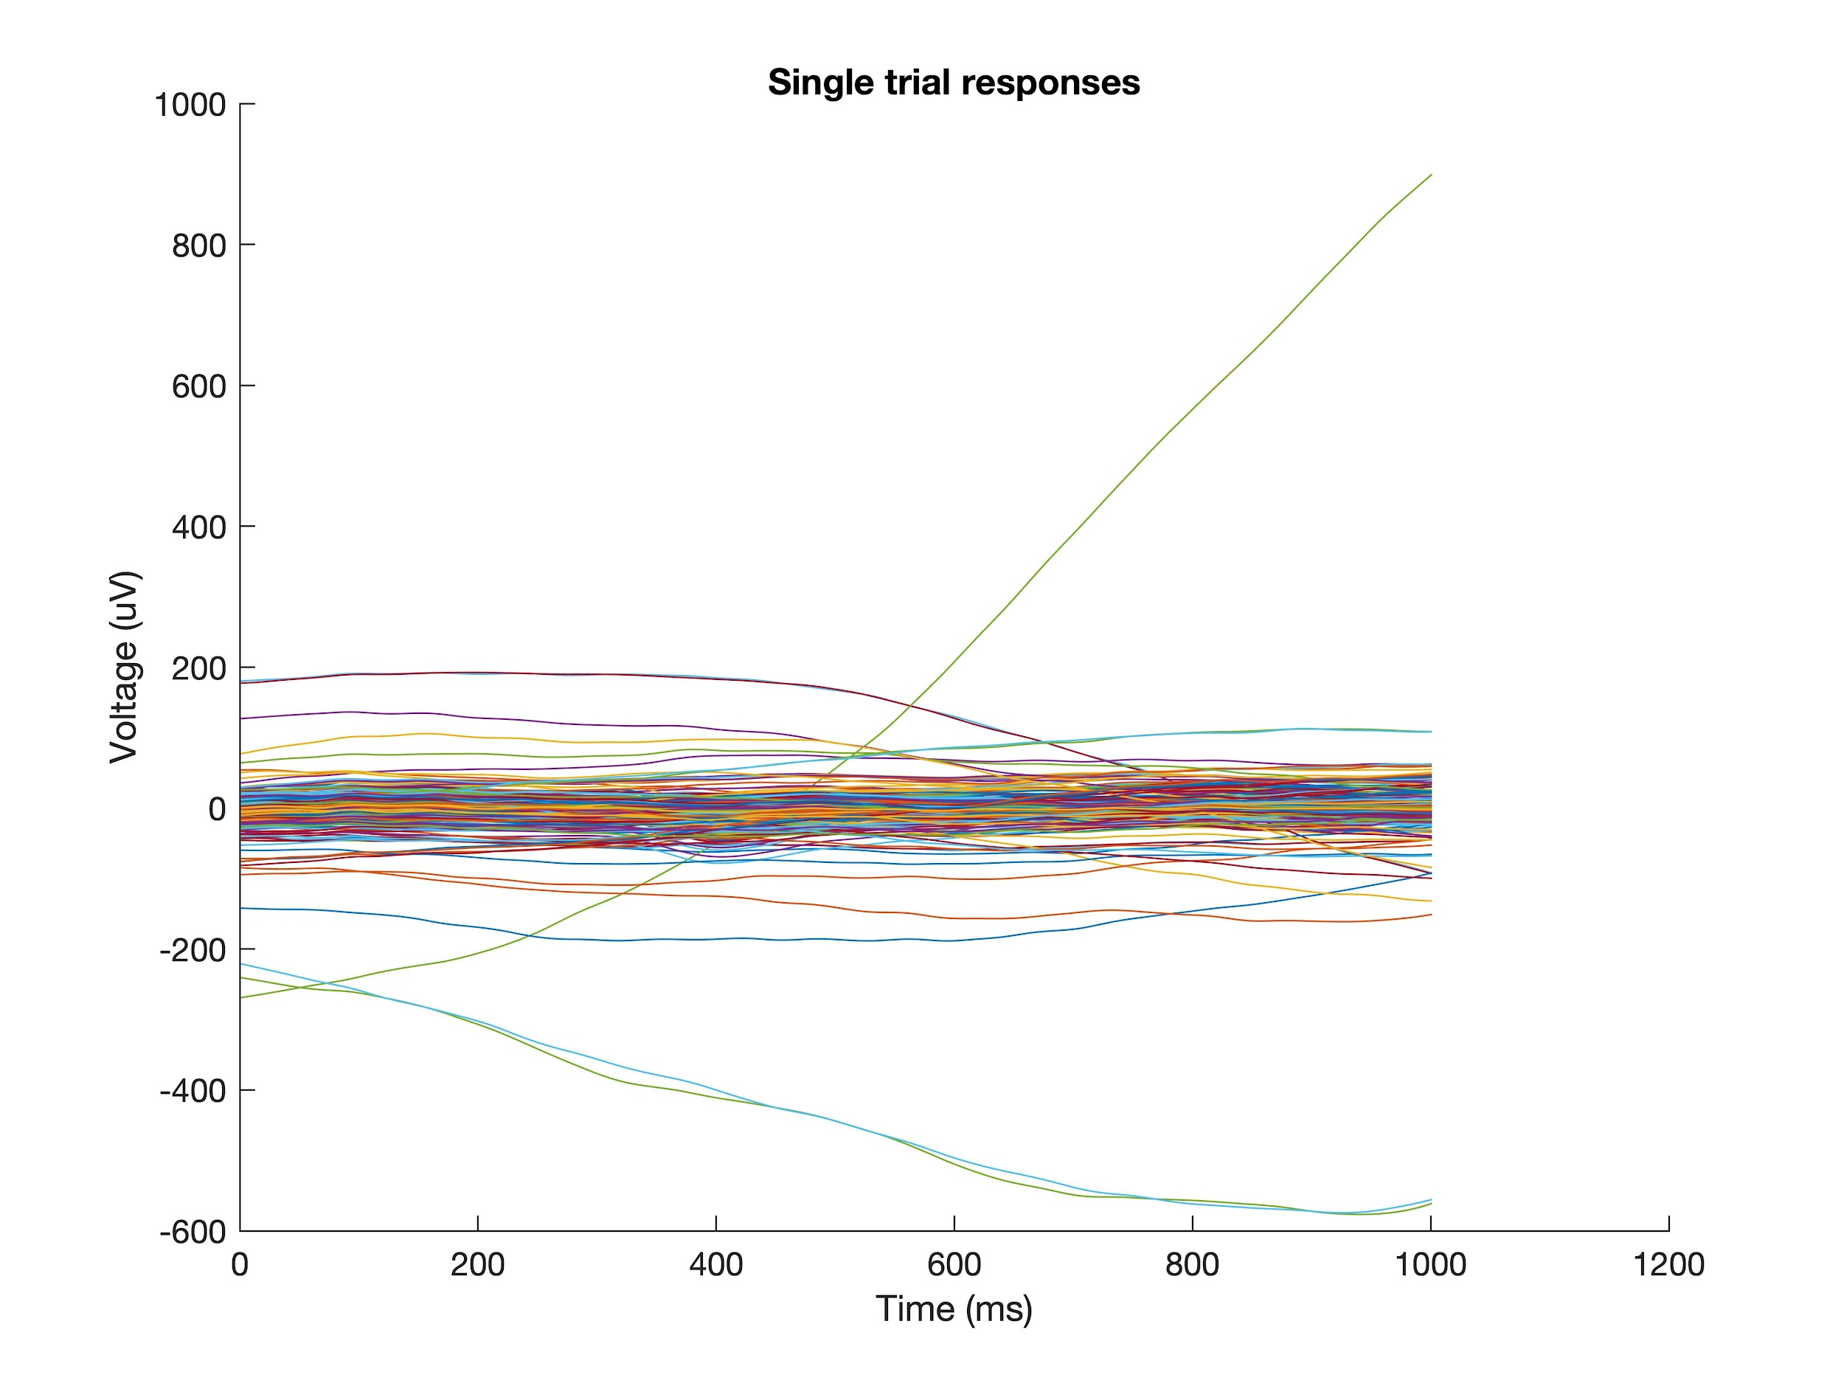
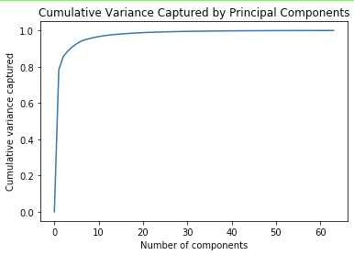
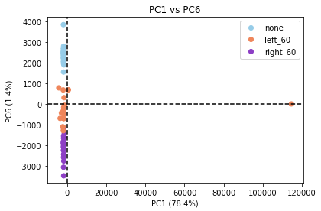
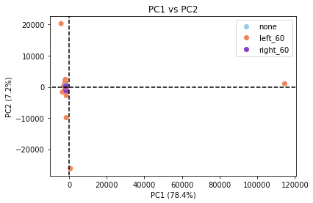
Analysis - PCA Outlier Detection

Slide 25
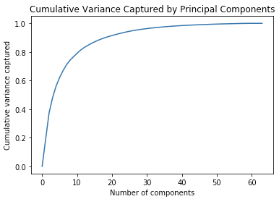
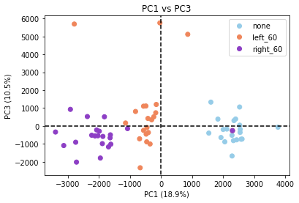
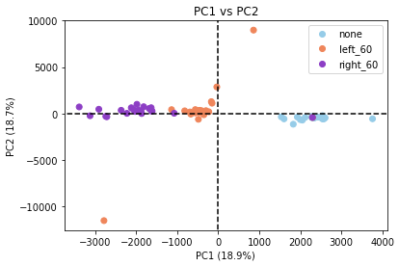
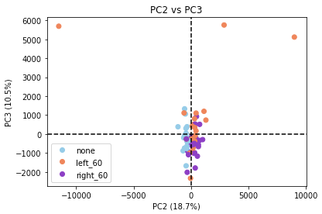
Analysis - PCA 3 Conditions
Notes:
Good separation
Cumvar shows earlier components capture more variance and it tapers off
PC1 seems particularly important for our question
Variance mainly due to L/R/None

Slide 26
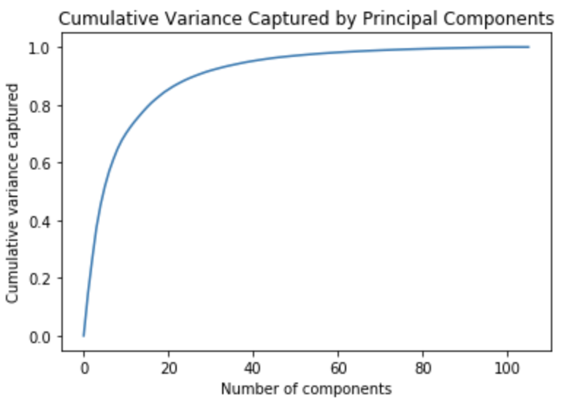
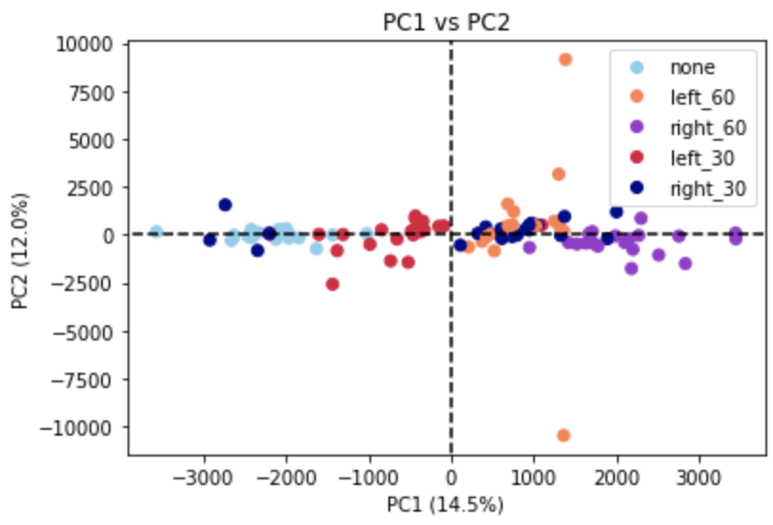
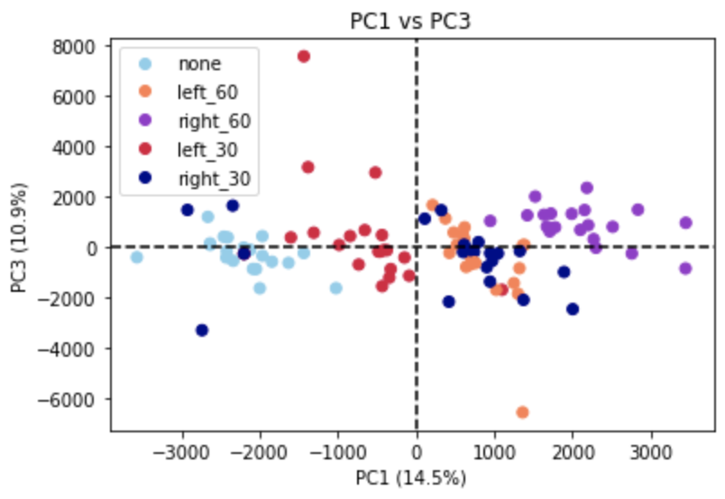
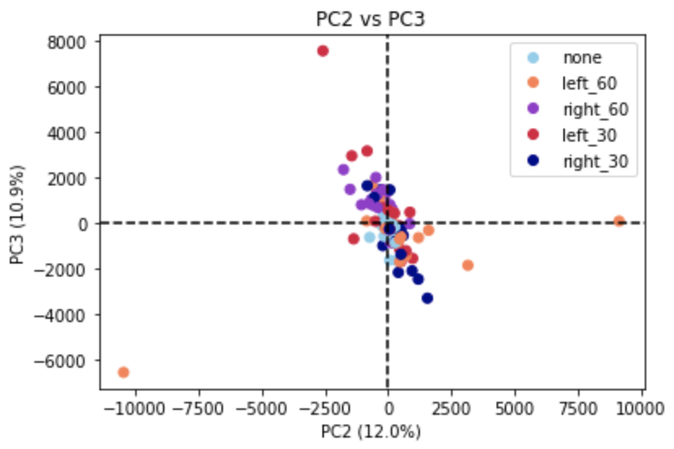
Analysis - PCA 5 Conditions
Notes:
Good separation
Cumvar shows earlier components capture more variance and it tapers off
PC1 seems particularly important for our question
Variance mainly due to L/R/None

Slide 27
Analysis - Outline
Preprocessing
Dimensionality Reduction and Feature Extraction
Classification

Slide 28
Analysis - LDA
Analysis - LDA
Analysis - Linear Discriminant Analysis (LDA)
Dimensionality reduction technique
Determine axes that maximize the separation between classes
Supervised - classes are labeled
Can be combined with PCA
Useful for classification
Notes:
The next step in our analysis pipeline is to take the PC transformed data and apply Linear Discriminant Analysis.
Like PCA, LDA is a dimensionality reduction technique that allows us to transform our data into a lower dimensional space, while preserving some important information.
While PCA aims to find a set of axes that maximizes variability, LDA determines new axes that maximize the separation between classes.
LDA is a supervised algorithm, meaning the class labels are provided to the model during training
Because LDA separates classes, it is useful for classification.

Slide 29
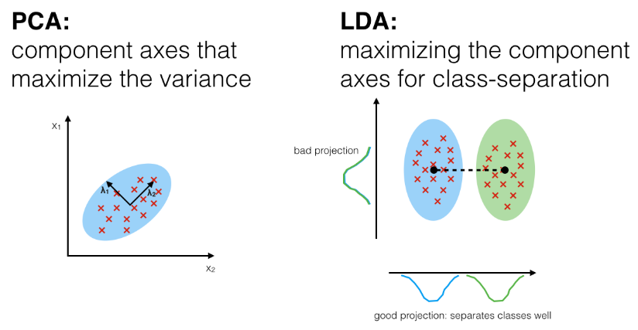
Anal
Analysis - LDA
http://sebastianraschka.com/Articles/2014_python_lda.html
Notes:
Here is an illustration comparing PCA and LDA, as you can see, PCA maximizes variance, while LDA maximizes class-seperation.

Slide 30
Analysis - LDA
Analysis - LDA
Analysis - LDA Implementation
Compute the mean vectors for each class
Compute the scatter matrices
S_{w} - within-class scatter
S_{b} - between-class scatter
Solve eigenvalue problem for A = S_{w}⁻¹S_{b}
Av=λv
Select linear discriminants
Sort eigenvectors by decreasing eigenvalues
Keep top-n eigenvectors
Transform input to the LD space
Notes:
The general implementation for LDA is described here.
First, mean vectors are computed for each class.
Second, within-class scatter and between-class scatter matrices are computed
These matrices are a measure of the spread of the data within classes and a spread of the data between classes.
Third, within-class scatter inverse and between-class scatter are multiplied, and eigenvector-values are computed.
Fourth the eigenvector-value pairs are ordered and the top-n vectors are kept.
Finally, these eigenvector-eigenvalues are applied to transform the input data to the LD space.

Slide 31
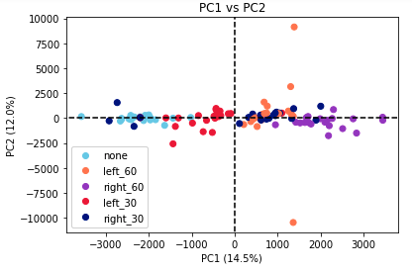
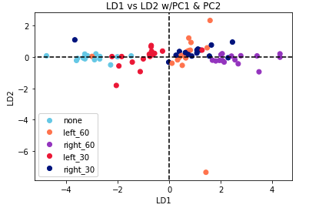
Analysis - LDA
Analysis - LDA
Analysis - PCA vs LDA
Notes:
Shown on the left is a plot of PC1 vs PC2, as you can see PC1 appears to be finding variance due largely to the different classes, but there is still some overlap of the classes.
On the right is a plot of LD1 vs LD2 using PC1 and PC2 as the input.
As you can see, the same general seperation of classes appears, but in the LD case, the within-group scatter is decreased, and the between-group scatter is increased, making classification easier.

Slide 32
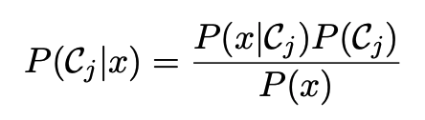
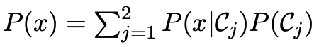
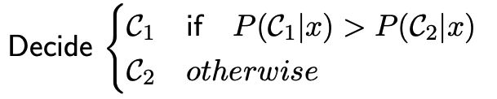
Analysis - Naive Bayes Classifier
Bayes Theorem
Estimate probabilities from LDA
Take class with highest conditional probability
https://web.fe.up.pt/~jsc/ML/lectures/lecture03.pdf
Notes:
Once our training data has been separated by LDA, we attempt to classify.
A Naive Bayes Classifier was used. This classifier works by using bayes theorem, shown on the left, where Cj are the classes, and x is the input.
Essentially, we are asking what is the probability of a certain class given our input.
We are able to estimate the probabilities in the right-side of Bayes theorem from our trained model.
The selected class is teh one with the highest conditional probability.

Slide 33
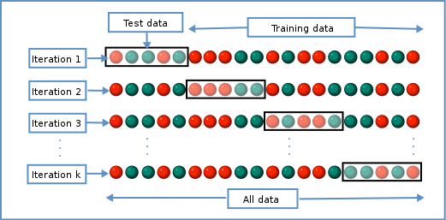
Analysis - K-Fold Cross-Validation
Split data into k sets
Iterate through test/train k times, swapping which set is used for testing each iteration
Helps to reduce bias in the estimate of the model’s performance
https://commons.wikimedia.org/wiki/File:K-fold_cross_validation_EN.svg
Notes:
We performed k-fold cross validation, in which our data was split into k sets and the model is trained and tested k times, switching which set is used for training and testing each iteration - this helps to reduce bias when estimting our model’s performance.

Slide 34
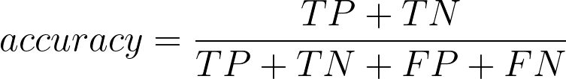
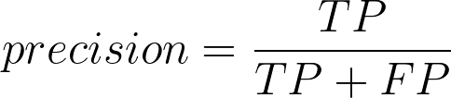
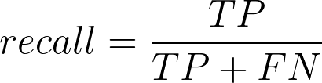
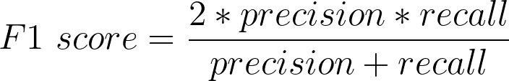
Analysis - Classifier Metrics
Notes:
When estimating the performance of our model we considered several metrics, listed here.
Each of these metrics estimate performance slightly differently, accounting for Type I and Type II errors.

Slide 35
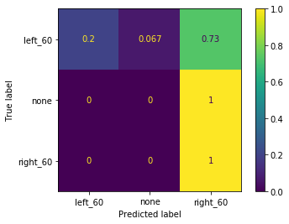

Anal
Results - 353 Channels, 3 Classes
Training
Testing
Notes:
These are results from our original analysis, in which we have included all “working channels”.
Shown here are normalized confusion matrices from using the first two PCs as input with a 75/25 train-train split.
The x-axis shows the predicted label and the y-axis shows the true label.
As you can see, the model is not very good. For the most part, it is classifying everything as right_60

Slide 36




Anal
Results - 353 Channels, 3 Classes
Notes:
These heatmaps show the models performance across different PCs and k-folds.
The x axis shows how many PCs are included in the input and the yy-axis shows the number of k-folds used for the training and testing - red indicates better performance.
Huge jump in performance with addition of 6th PC, and analysis with just 6th PC also shows good performance.
First 5 PCs must be finding variation due to other sources - further analysis and preprocessing of data was then performed

Slide 37


Anal
Results - 310 Channels, 3 Classes
Training
Testing
Notes:
These are results from our reduced channel analysis, in which we have included all “working channels”. Individual channels we removed based on their waveforms exceeded the limits of biologically relevant amplitudes.
These are confusion matrices from using the first two PCs as input with a 75/25 test-train split.
The model performs much better with this data set.

Slide 38




Anal
Results - 310 Channels, 3 Classes
Notes:
Again, these heatmaps show the models performance across different PCs and k-folds.
This model generally performs well, even with a limited number of PCs

Slide 39


Anal
Results - 310 Channels, 5 Classes
Training
Testing
Notes:
These are results from our 5 class dataset
These are confusion matrices from using the first two PCs as input with a 75/25 test-train split.
As you can see, the model shows mixed performance. It is very good at classifying left_30 and right_60, but struggles with left_60 and right_30.

Slide 40




Anal
Results - 310 Channels, 5 Classes
Notes:
Again, these heatmaps show the models performance across different PCs and k-folds.
As you can see, this model is more sensitive to the number of PCs included and the number of k-folds used. But it appears that including 8 PCs and 7-k-folds results in 80% performance.

Slide 41


Anal
Conclusion
We can detect and classify single evoked potentials in a short time-window of data recorded from a 300+ channel microelectrode array placed subdurally on the spinal cord surface.
Initial hypothesis: extracting the top principal component (PC) from the input data will be sufficient to achieve a 50% classification accuracy rate via a multiclass linear discriminant analysis.
False for originally selected data with bad channels only removed based on impedance
PC #6 necessary to classify data with accuracy > 50%
True for cleaned data where additional bad channels are removed
PC #1 classified data with accuracy ~ 60%
Code: https://github.com/margotwagner/COGS260
Notes:
https://github.com/margotwagner/COGS260

Slide 42
Supplementary Slides

Slide 43


Analysis - Naive Bayes Classifier
Bayes Theorem
Calculate P(x|C_{j}) from LDA
Assume P(C_{j}) from LDA
Take class with highest conditional probability
https://web.fe.up.pt/~jsc/ML/lectures/lecture03.pdf

Slide 44



Anal
Additional Slides - PCA 353 Channels

Slide 45








Anal
Additional Slides - PCA 353 Channels PC1

Slide 46








Anal
Additional Slides - PCA 353 Channels PC6

Slide 47



Anal
Additional Slides - PCA 353 Channels Other

Slide 48



Anal
Additional Slides - PCA 353 Channels Other

Slide 49



Anal
Additional Slides - PCA 353 Channels Other

Slide 50



Anal
Additional Slides - PCA 353 Channels Other

Slide 51


Anal
Additional Slides - PCA 353 Channels Other

Slide 52
Confusion matrix - 353 channels
Training
Testing

Slide 53
Heatmaps - 353 Channels

Slide 55



Anal
Additional Slides - PCA 310 Channels 3 Conditions

Slide 56



Anal
Additional Slides - PCA 310 Channels 3 Conditions

Slide 57



Anal
Additional Slides - PCA 310 Channels 3 Conditions

Slide 58



Anal
Additional Slides - PCA 310 Channels 3 Conditions

Slide 59



Anal
Additional Slides - PCA 310 Channels 3 Conditions

Slide 60



Anal
Additional Slides - PCA 310 Channels 3 Conditions

Slide 61



Anal
Additional Slides - PCA 310 Channels 3 Conditions

Slide 62



Anal
Additional Slides - PCA 310 Channels 3 Conditions

Slide 63
Confusion matrix - 310 channels, 3 groups
Training
Testing

Slide 64
Heatmaps - 310 Channels, 3 groups

Slide 66



Anal
Additional Slides - PCA 310 Channels 5 Conditions

Slide 67



Anal
Additional Slides - PCA 310 Channels 5 Conditions

Slide 68



Anal
Additional Slides - PCA 310 Channels 5 Conditions

Slide 69



Anal
Additional Slides - PCA 310 Channels 5 Conditions

Slide 70



Anal
Additional Slides - PCA 310 Channels 5 Conditions

Slide 71



Anal
Additional Slides - PCA 310 Channels 5 Conditions

Slide 72



Anal
Additional Slides - PCA 310 Channels 5 Conditions

Slide 73



Anal
Additional Slides - PCA 310 Channels 5 Conditions

Slide 74
Confusion matrix 310 channels, 5 groups
Training
Testing

Slide 75
Heatmaps - 310 Channels, 5 groups

Slide 76
Example bad channels

